Slide 1
Pothole Detection using AI
Using FRCNN and YOLO algorithms
Project Under the course of Artificial Intelligence
Arjun Khare 2019214 Instructor: Kusum Kumari Bharti
Arihant Jain 2019213

Slide 2
What are Potholes?

Slide 3
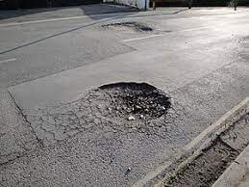
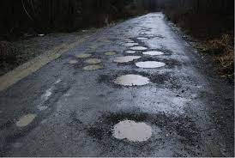
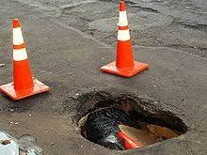
Pothole
A pothole is a depression in a road surface, usually asphalt pavement, where traffic has removed broken pieces of the pavement. It is usually the result of water in the underlying soil structure and traffic passing over the affected area.

Slide 4
How to Detect Potholes?

Slide 5
How to Detect
One method can be detecting it manually, but it is very painful, time consuming and not feasible.
Here we can take advantage of our computers and their powerful processing and computing capabilities.
People have researched various algorithms and techniques for object Detection and using these we can also detect Potholes.

Slide 6
Implementation of Research Paper

Slide 7
Research Paper we implemented
A Modern Pothole Detection technique using Deep Learning
Authors
Abhishek Kumar
Gaya College of Engineering, Gaya, Bihar, India
Chakrapani
Gaya College of Engineering, Gaya, Bihar, India
Dhruba Jyoti Kalita
Gaya College of Engineering, Gaya, Bihar, India
Vibhav Prakash Singh
National Institute of Technology, Allahabad, UP, India
Research Paper => https://ieeexplore.ieee.org/document/9170705
Used Faster-RCNN (FRCNN) for the detection of Potholes.

Slide 8
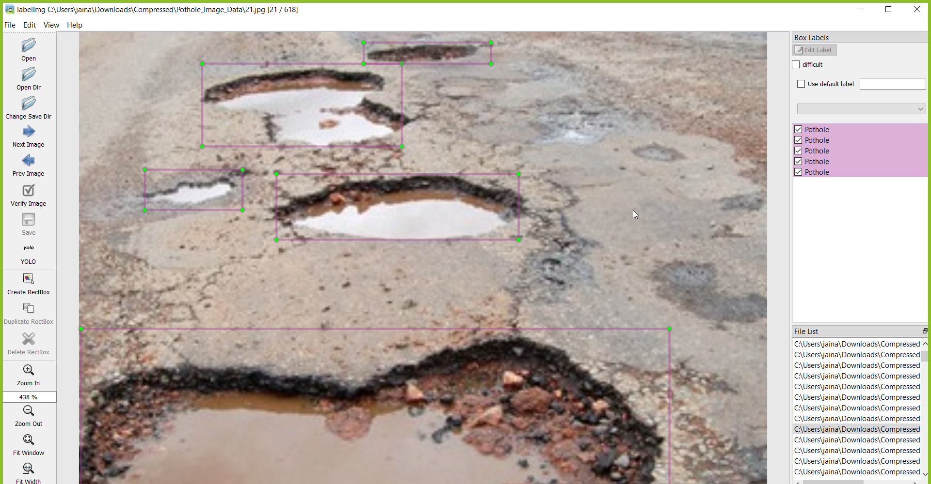
Creating Dataset
Dataset Link - https://www.kaggle.com/sachinpatel21/starter-code-to-view-dataset-images/data
Image labelling using - https://github.com/tzutalin/labelImg
We had got the Pothole images dataset and we had used labelImg which is an open tool for labelling your images.

Slide 9
Training of Faster-RCNN
TensorFlow provides several object detection models (pre-trained classifiers with specific neural network architectures) in its model zoo.
link to the models - https://github.com/tensorflow/models/tree/master/research/object_detection/models
And we choose the required F-RCNN model from it.
Now we trained our model using:
prepared dataset
.pbtxt file (which contains the labels)
train.record(which contain config of every image contained in the train folder)
test.record (similar to train.record)
and the base model obtained from tensorflow.

Slide 10
Testing of Faster-RCNN
For testing we used:
.pb file (Trained Model file)
.pbtxt file (contained the labels)
Testing image
Class file
Now after executing the driver code with the aforesaid requirements we get our detection results.

Slide 11
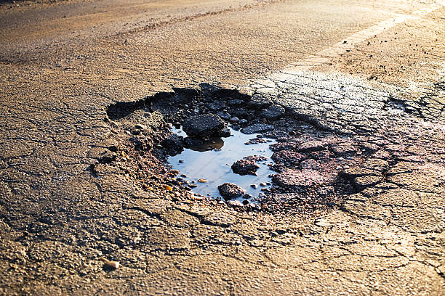
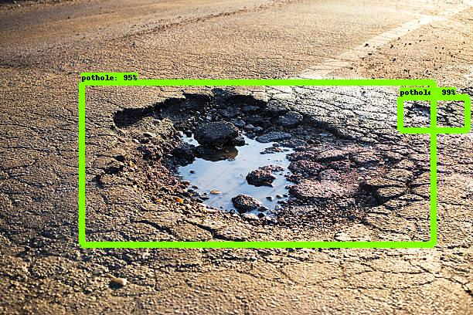
Detection Results of Faster-RCNN
The model is effectively able to predict potholes and a group of potholes from images and videos provided to it.
The model works similar to the model suggested in the research paper, and the results are good.

Slide 12
Improvement of previously implemented research paper

Slide 13
Improvement of our previous detection model
YOLO Object Detection Algorithm
YOLO is an algorithm based on regression and is a single-step process wherein, in one run, the image is screened, and objects are located with the bounding boxes as well as their class is predicted in the same run.
It is generally used for real-time detection where time, speed, and accuracy form prime concerns, it is primarily used in the application of Artificial intelligence and Deep Learning.
After much research and testing we found about YOLO Object Detection Algorithm which we thought would perform better with respect to Faster-RCNN.

Slide 14
Creating Dataset
Dataset Link - https://www.kaggle.com/sachinpatel21/starter-code-to-view-dataset-images/data
Image labelling using - https://github.com/tzutalin/labelImg
We had got the Pothole images dataset and we had used labelImg which is an open tool for labelling your images.

Slide 15
Training of YOLO Object Detection Algorithm
YOLO is based on the darknet, built in C. Darknet is an open source neural network framework written in C and CUDA.
link to the darknet- https://github.com/pjreddie/darknet
And we chose YOLO v3 model from it.
Now we trained our model using:
prepared dataset
Config file (contains CNN Architectures (layers and activations) Anchor Boxes, Number of classes, Learning Rate, Optimization Technique, input size, probability score threshold, batch sizes )
Default darknet weight (required for initial epochs)
Obj.data (contains train.txt, test.txt which further contains the path to dataset images, backup and number of classes)
Obj.names (to name classes)

Slide 16
Testing of YOLO Object Detection Algorithm
For testing we used:
Trained Weights file (updated automatically after regular intervals while training)
Obj.data
Config file
Testing image
Command to Test :
darknet detector test <obj.data> <config> <weights> <image>
Example:
darknet detector test custom-cfg/obj.data custom-cfg/yolo-pothole-train.cfg .\custom-backup\yolo-pothole-train_last.weights .\test_17.jpg

Slide 17
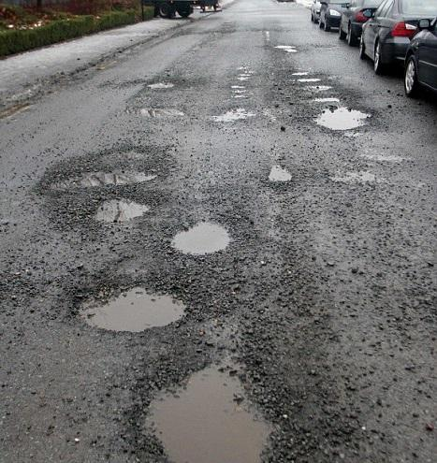
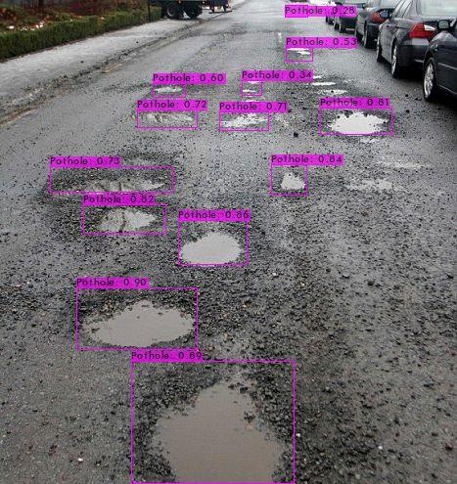
Detection Results of YOLO Object Detection Algorithm
The model is effectively able to predict potholes and a group of potholes from images and videos provided to it.
The model works nicely and the results are good.

Slide 18
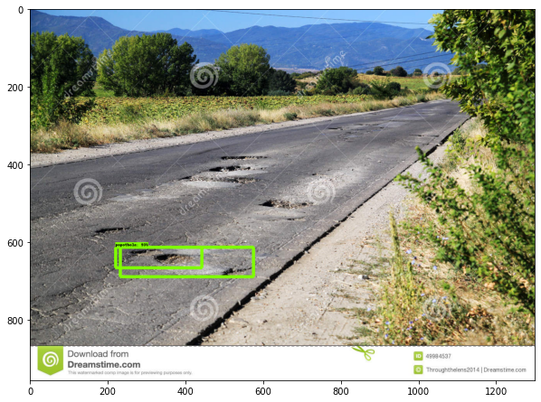
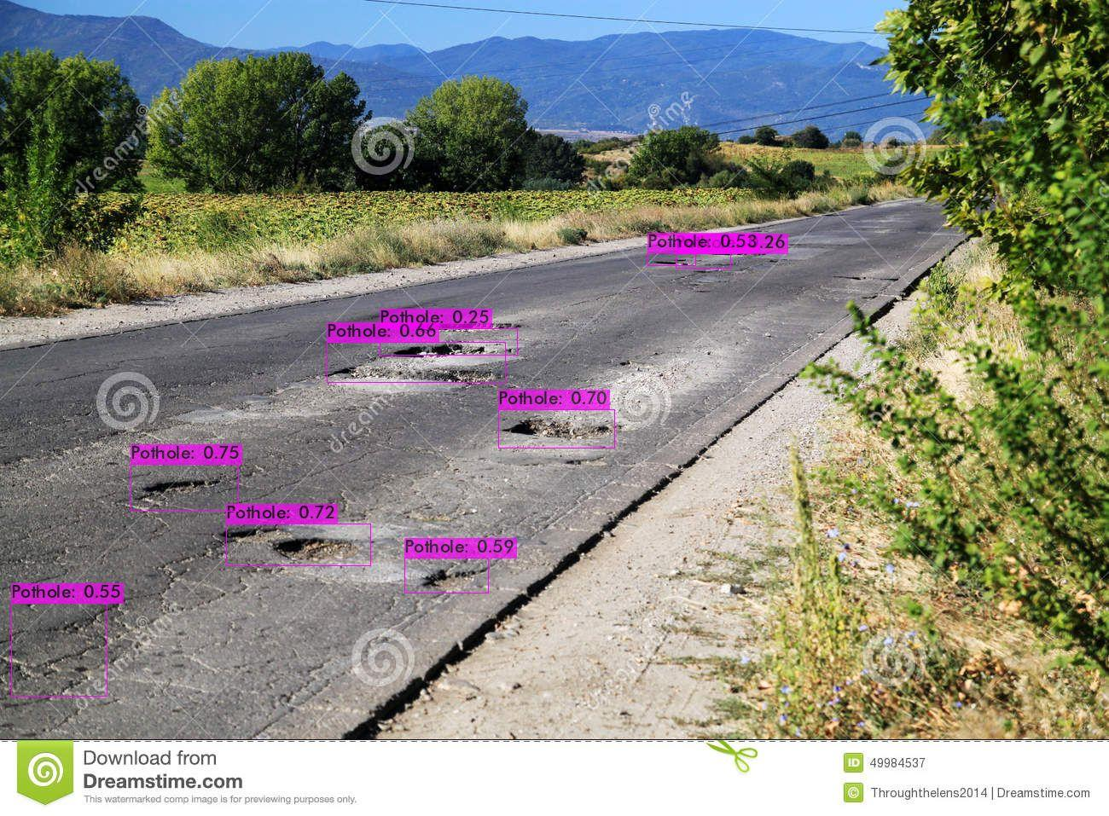
Comparison between Implementation of Research Paper and its Improvement
FRCNN does not have a wide range in detection of Potholes whereas YOLO detects almost every Pothole within a wide range.
FRCNN’s most of the detections are of large Potholes whereas YOLO tries to detect small Potholes also.
FRCNN takes more time in detection than YOLO.

Slide 19
Conclusion
Both the models were effectively able to detect potholes from images and videos provided to it.
It was easily concluded that YOLO performs better than FRCNN with respect to speed and accuracy.

Slide 20
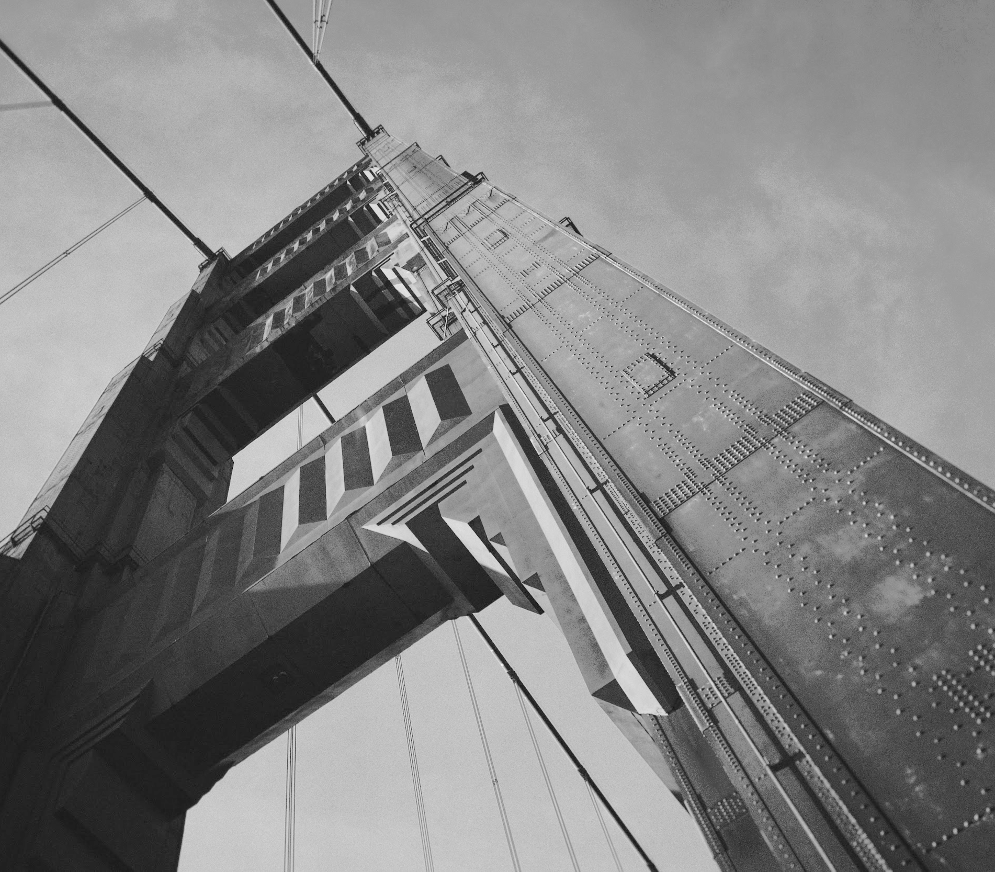
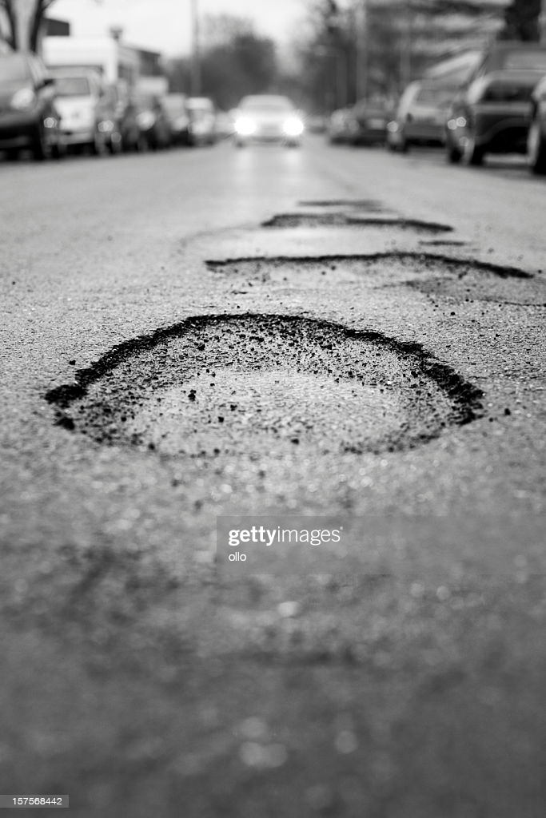
Thanks!
Drive Safe !!
The Roads are full of Potholes

